Slide 1

Behavioural and Social-Engineering Based Detection of UPI Transactional Fraud Using Machine Learning
A comprehensive machine learning framework for identifying fraudulent transactions through behavioural analysis and psychological manipulation indicators in India's digital payment ecosystem.

Slide 2

The Growing Challenge of UPI Fraud
The Unified Payments Interface (UPI) has revolutionised India's digital economy, enabling instantaneous peer-to-peer financial transfers. However, this convenience has introduced significant vulnerabilities to social-engineering-based financial crimes.
According to the National Payments Corporation of India (NPCI), UPI transactions surpassed 13 billion in 2025, with a corresponding rise in fraud reports. Modern fraudsters exploit psychological manipulation—urgency, trust, and misinformation—rather than traditional brute-force techniques.

Slide 3
The Evolution of Fraud Detection
Rule-Based Systems
1
Traditional heuristic approaches with predefined thresholds—limited in detecting subtle behavioural deviations
2
Classical ML
Support Vector Machines and Decision Trees offering interpretability but sensitivity to outliers
Ensemble Methods
3
Random Forest and Gradient Boosting combining weak learners for robust performance on imbalanced datasets
4
Deep Learning
LSTM networks and GANs for sequential pattern detection, though computationally intensive
Behavioural Analytics
5
Human-aware models blending psychological indicators with transaction data

Slide 4

Critical Insight: Human Vulnerability
Over 60% of digital payment frauds involve human engineering rather than technical compromise. Human error, not system vulnerability, acts as the weakest security link.
This underscores the necessity for fraud detection models that quantify behavioural irregularities and psychological manipulation triggers—moving beyond traditional rule-based approaches to understand the context and intent behind transactions.

Slide 5





Proposed Methodology: Five-Stage Architecture
Data Synthesis
Generation of 10,000 simulated UPI transactions with 12 attributes, ensuring privacy whilst maintaining realistic feature variance
Preprocessing
Normalisation and transformation of raw transaction data into quantifiable indicators
Feature Engineering
Extraction of temporal, behavioural, and social-engineering markers
Classification
Random Forest ensemble with optimised hyperparameters and adaptive class weighting
Evaluation
Comprehensive performance analysis across multiple metrics

Slide 6



Feature Engineering: Quantifying Behavioural Anomalies
Temporal Features
Behavioural Deviation
Social Engineering Index
Cyclical encoding captures diurnal periodicity using sine and cosine transformations, avoiding artificial discontinuities between hours.
Measures transaction amount anomaly relative to user's historical spending patterns.
Weighted combination of manipulation triggers—new beneficiaries, device changes, collect requests.
High Di indicates behavioural irregularity.

Slide 7
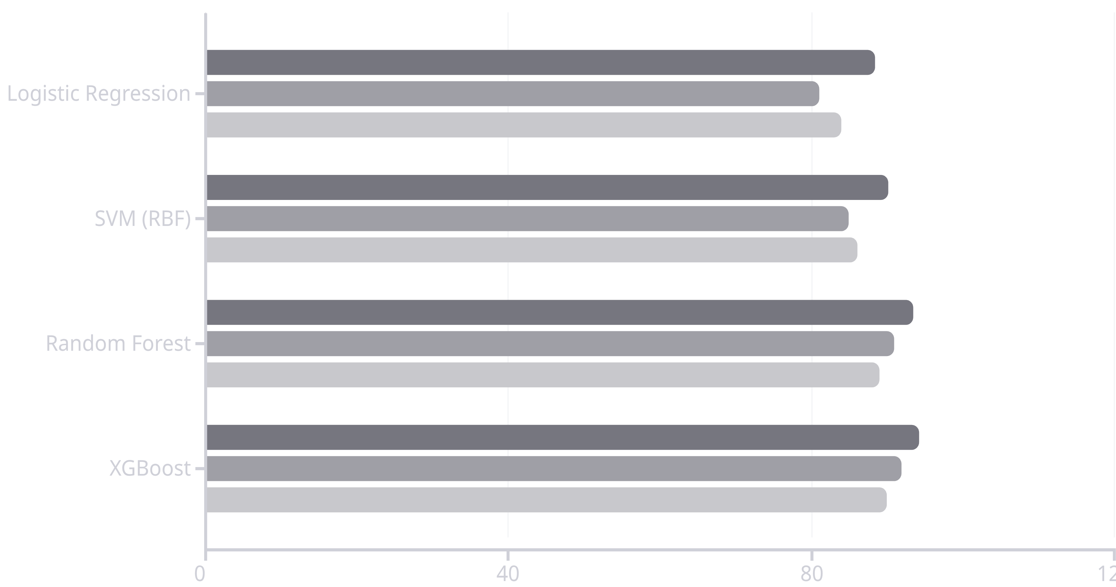
Model Performance: Experimental Results
Accuracy (%)
Recall
F1-Score
Ensemble classifiers significantly outperformed linear models due to their capacity to capture nonlinear decision boundaries. Random Forest demonstrated robust detection capability with minimal false positives, making it suitable for real-time deployment scenarios.

Slide 8
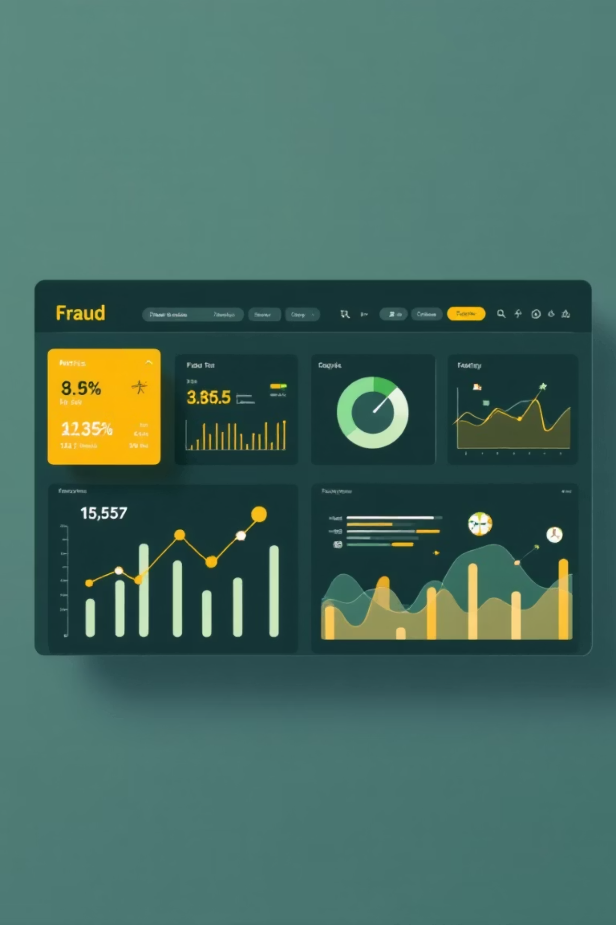
Key Performance Indicators
93.4%
0.91
0.96
Overall Accuracy
Recall Score
AUC-ROC
Classification correctness across all transaction types
Capability to identify actual fraudulent transactions
Area under curve indicating high class separability
0.34
Prediction Entropy
Low uncertainty in classification outcomes

Slide 9



Feature Importance Analysis
Amount Deviation (Di)
Strongest predictor—transactions significantly deviating from user's spending patterns
Collect Request Frequency
Second most influential—repeated collection requests indicate manipulation attempts
New Beneficiary Detection
Transactions to previously unknown recipients raise suspicion levels
Device Change Indicators
Sudden device switching patterns suggest potential account compromise

Slide 10
Conclusions and Future Directions
Research Contributions
Future Work
Reproducible, lightweight architecture for UPI fraud detection
Semi-supervised learning for evolving fraud schemes
Real-time adaptive feedback systems
Integration of behavioural deviation and social-engineering triggers
Federated and differential privacy mechanisms
Deployment on consumer hardware with minimal latency
Privacy-conscious synthetic data methodology
High interpretability for banking audit workflows
Authors: Samarth Karmakar, Krishiv Kolanu, Smrithi Kothandaraman | Manipal Institute of Technology, Manipal, India

